Slide 1
Day -1

Slide 2
Outcomes
Overview of .net Framework

Slide 3


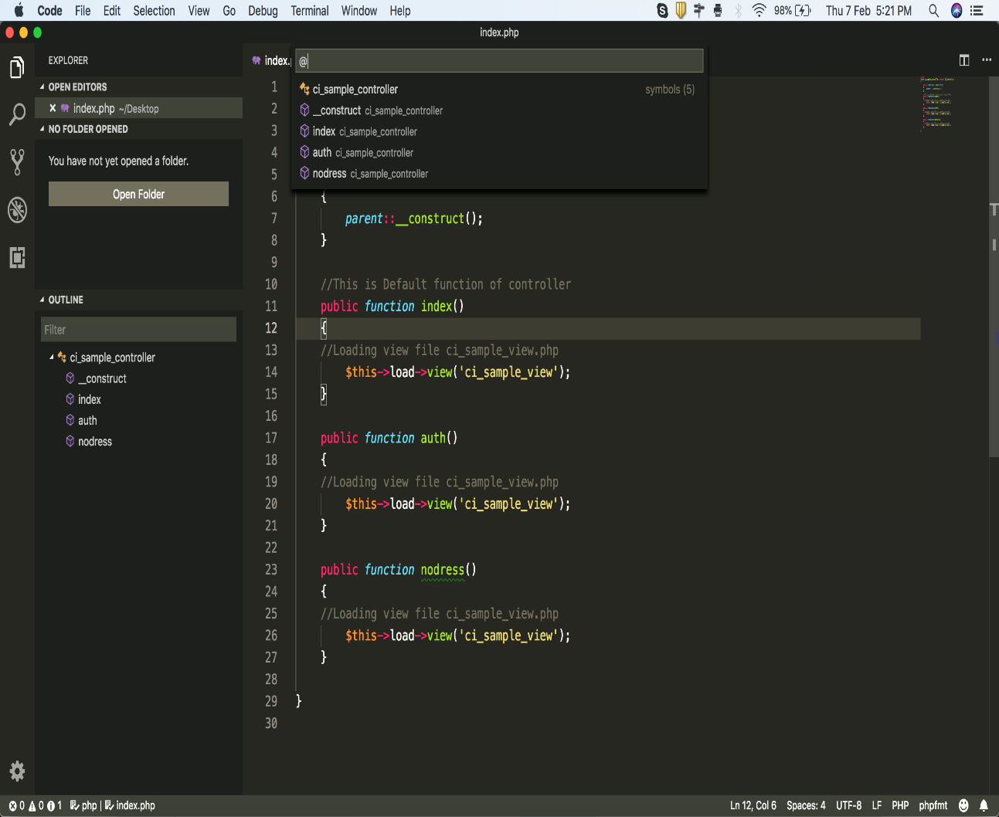
Framework

Slide 4
Purpose & Feature
Purpose:
Create dynamic web pages instead of static HTML files.
Build web applications like social media platforms, e-commerce websites, and content management systems.
Develop RESTful APIs for communication between different systems.
Enable real-time features like chat applications or live updates.
Key Features:
Language flexibility
Rich ecosystem
Cross-platform compatibility
ML

Slide 5
Components
Components:
ASP.NET MVC (Model-View-Controller)
ASP.NET Web API (Application programming interface)
ASP.NET Core

Slide 6
Environment System
Visual Studio:link
SQL Server:link
SQL Server Management System:link

